Slide 1
Emerging Technology Project: Wearable Technology
Presented by:
Iris Castillo
Douglas J. Koch
Manuel F. Negron

Slide 2
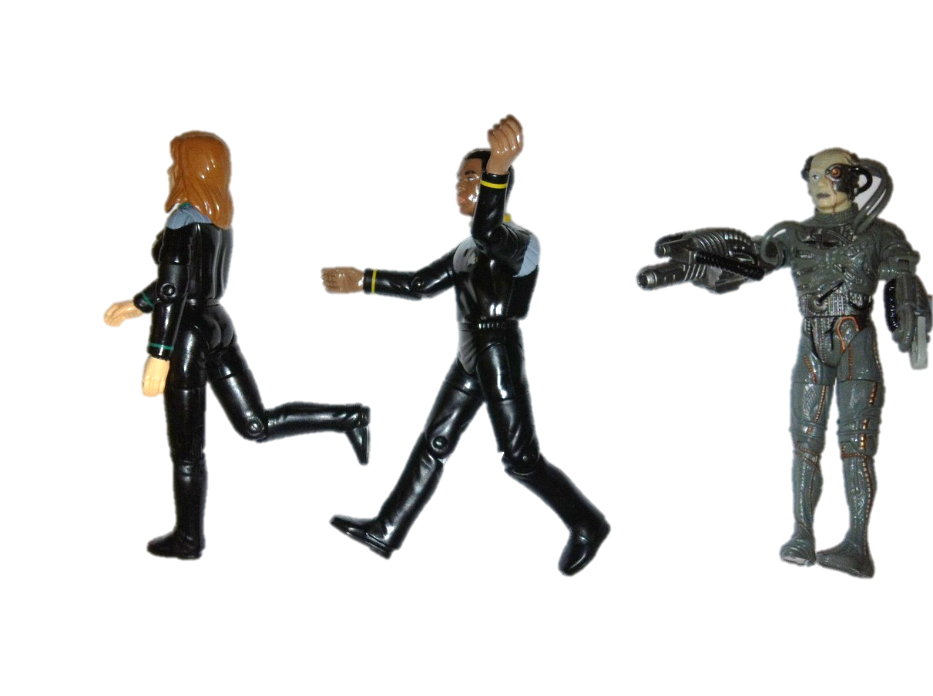
You can’t run away from technology…
…resistance is futile

Slide 3
Module Outline
Overview
Benefits and Limitations
Educational
Future
Online Discussion Prompts
Notes:
Lesson descriptions should be brief.

Slide 4
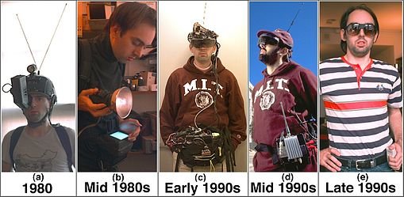
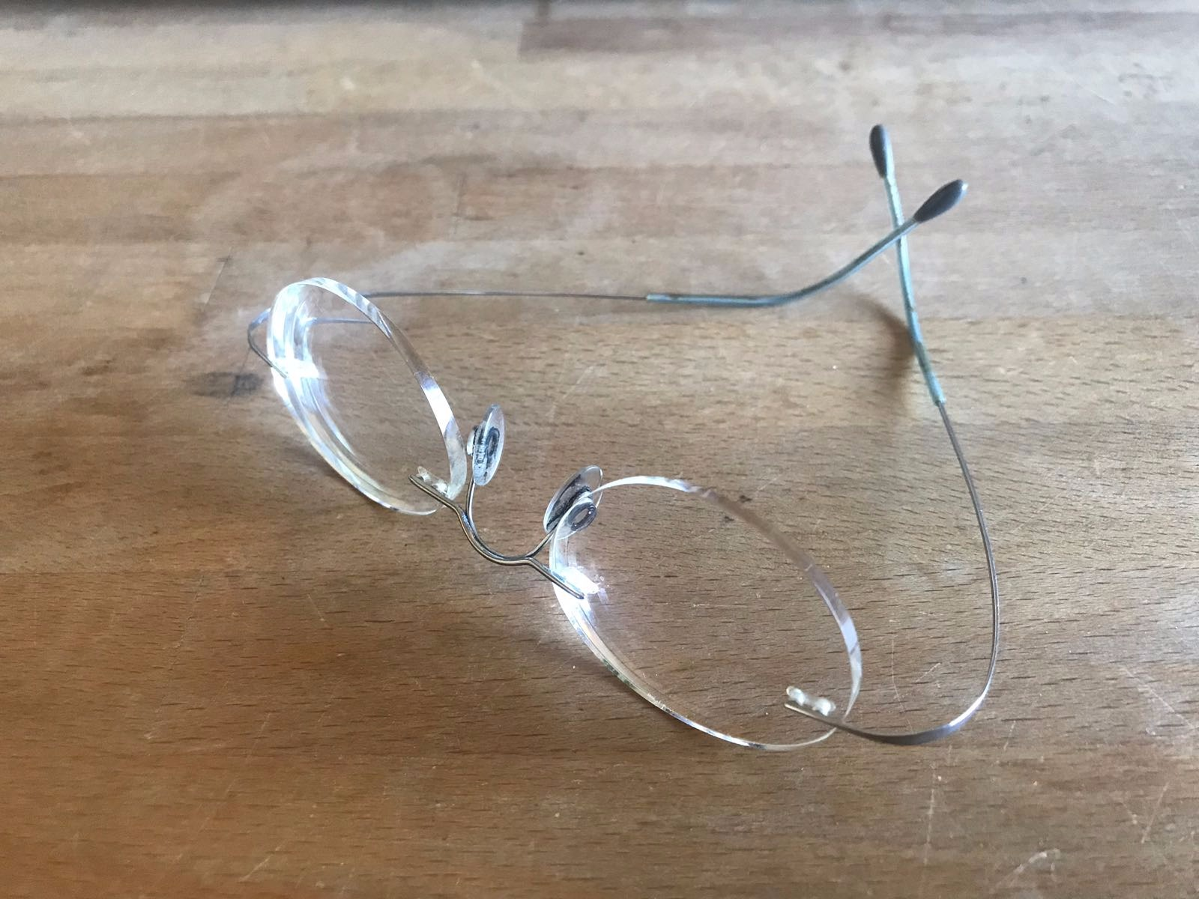
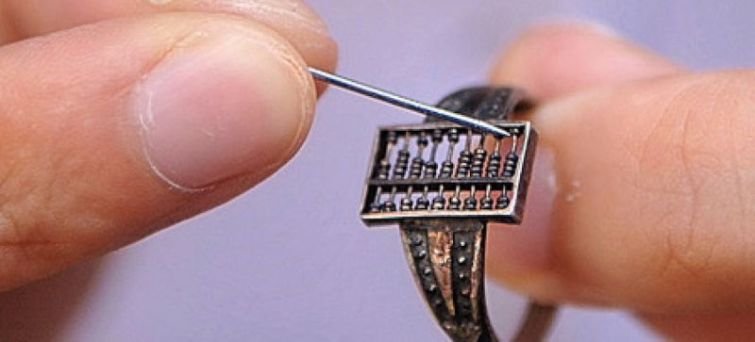
History – Wearable Technology
Abacus ring
Eyeglasses
Pocket and Wrist Watch
Computer linked camera
Medical devices (heart rate monitors, insulin pumps, clinical force sensing gloves)
Virtual Reality
Fitness trackers
Smart Clothes
Music
Notes:
Abacus ring: https://gizmodo.com/this-wearable-abacus-is-basically-the-worlds-oldest-sm-1545627562
Google Glass: http://www.business2community.com/tech-gadgets/5-reasons-google-glass-miserable-failure-
01462398#vY0OjHRRdUpmQDyj.97
Eyeglasses 12th centaury.
Pocket watch first mentioned in the mid 15th centaury.
Wrist watches in the 16th centaury.
Clinical force sensing gloves: https://www.google.com/patents/US20110302694
Insulin pump: https://www.healthable.org/the-evolution-of-the-insulin-pump/
Fitness trackers: https://article.images.consumerreports.org/prod/content/dam/cro/magazine-articles/2016/February/CR-Magazine-AH-Are-You-Keeping-track-12-15
Smart watches: https://cdn2.techadvisor.co.uk/cmsdata/features/3497103/best_smartwatches_thumb800.png

Slide 5
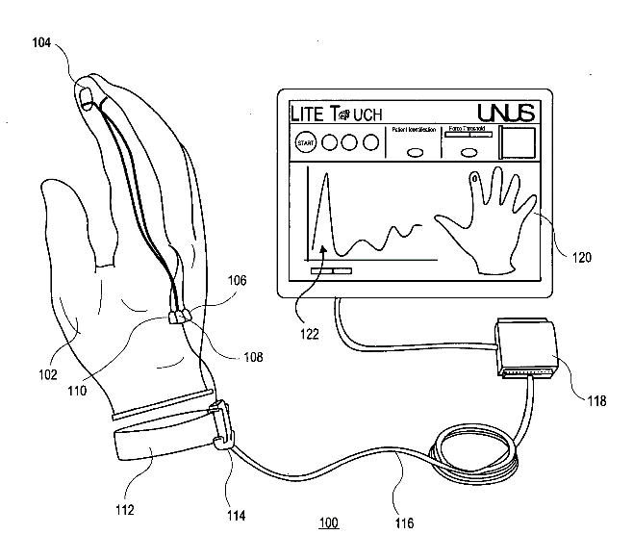
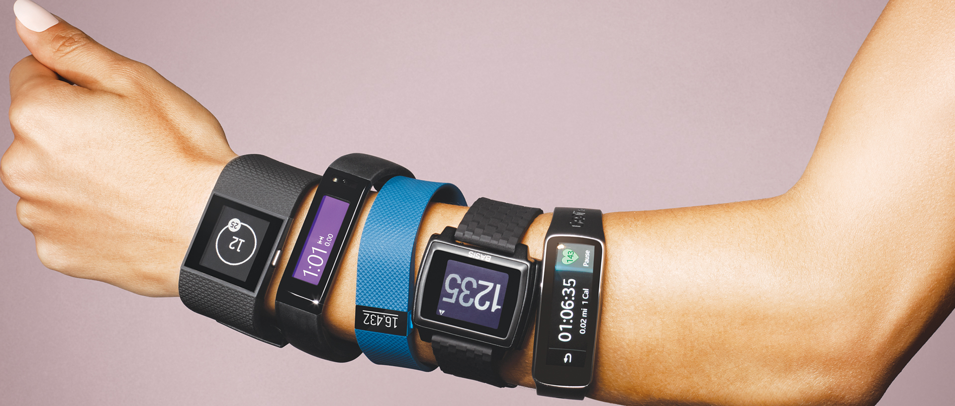
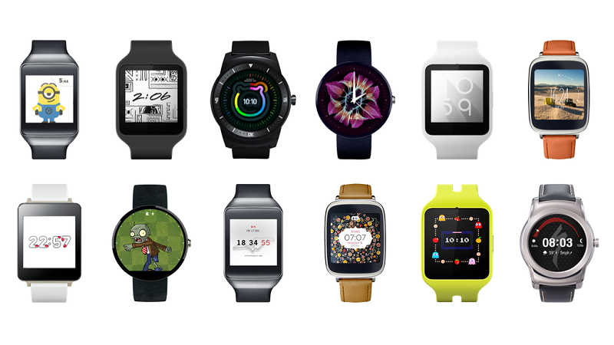
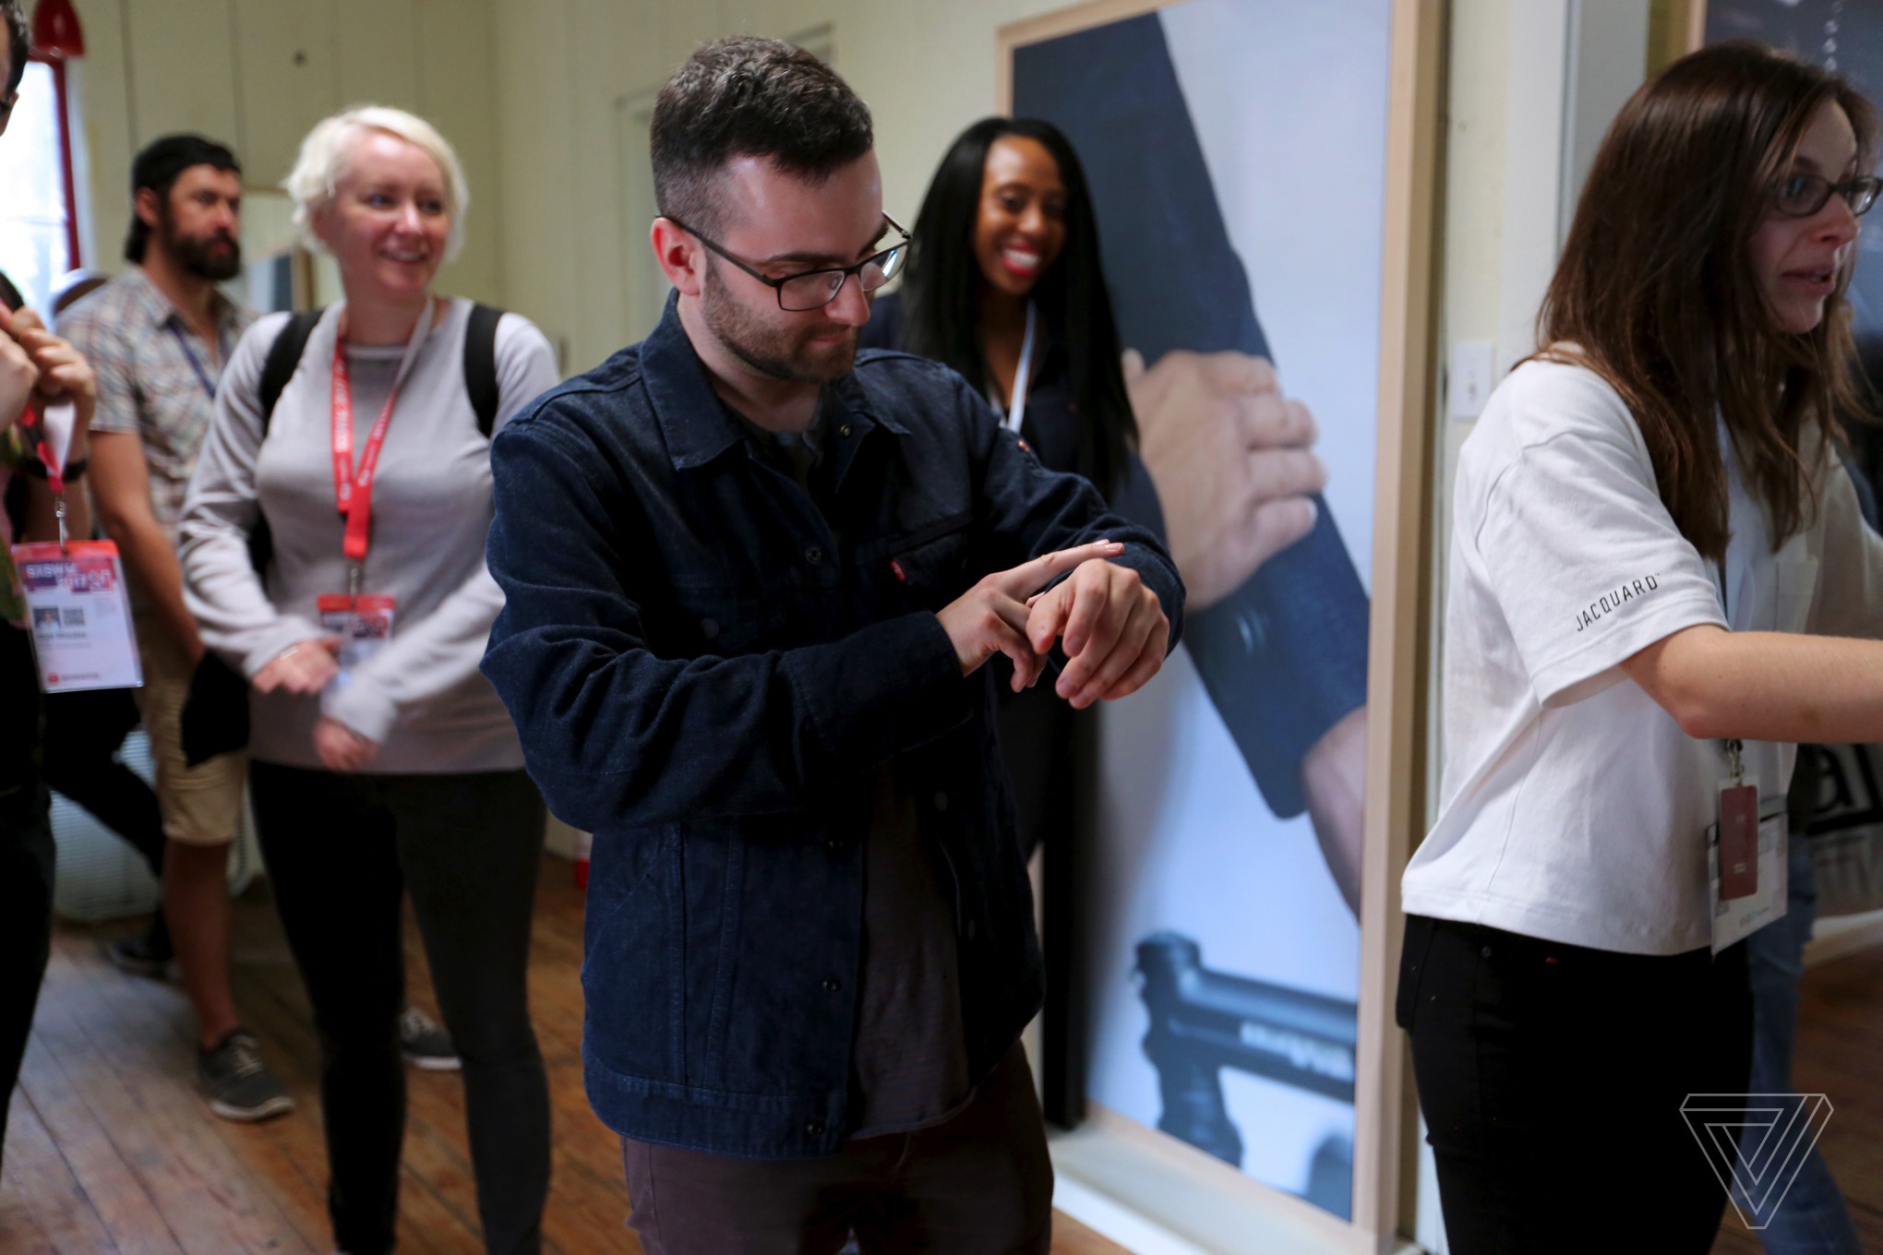
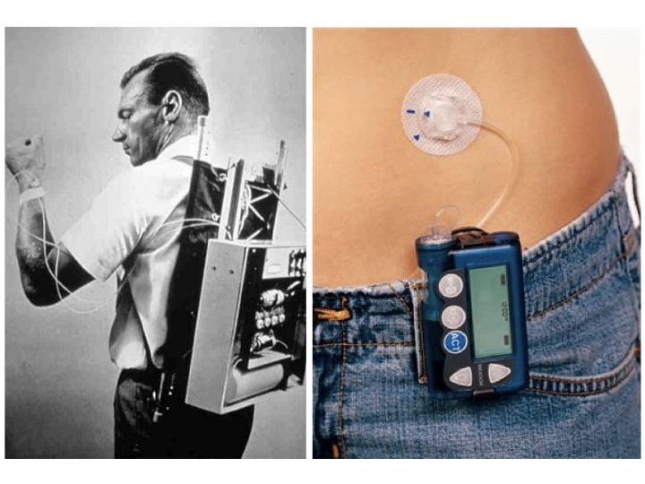
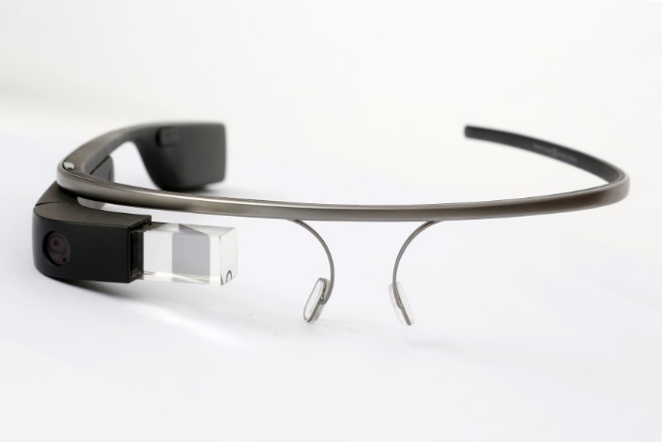
Main Classes
Clothing
Medical
Visual / Augmented Reality
🎩
Fitness / Location Tracker
Watch
🕶
SPY TECHNOLOGY

Slide 6
Fitness Trackers
Fitbit
Smart Watches
Smart Phones
Ring

Slide 7
Benefits and Limitations
Personal Accountability
Individually Tailor Your Goals
Make It All About You!!
Financial Motivation
Current Weight Loss Tool
Group Dynamics
Incentives Promote Activity in the Workplace
Variety of Trackers
Sleep
Motivation
Notes:
Personal Accountability - Track your goals and progress; encouraging you to do more than you did yesterday.
Individually Tailor Your Goals – provides workouts, tips, and realistic goals you can set for yourself depending on what your goal is (ex. Prepping for a 5k run).
Make It All About You!! – Rely on them and tune into them to assure that you are working out for you.
Financial Motivation – If you are going to spend the money (over $100) on one; you might as well use it to your advantage.
Current Weight Loss Tool – Allows you to determine if you are on the right track to your desired weight loss goal.
Group Dynamics – Allows you to post your progress on social media and create workout groups or challenges.
Incentives Promote Activity in the Workplace – Builds morale in the workplace through workplace challenges (ex. The Biggest Loser, 10k Step Challenge, etc.)
Variety of Trackers – Customizable to your needs.
Sleep – Tracks the quality of your sleep through movement.
Motivation – When you fail to reach your daily step goal, trackers motivate you to do better and walk more the next day.

Slide 8
Benefits and Limitations
Some fitness trackers track steps and progress incorrectly.
Due to budgetary reasons, school districts do not always go for the best tech model . Keeping accountability of your steps on the most basic and cheapest fitness tracker requires for you to check it on a smartphone app or on your computer which may not be easily accessible for students.
Pure Pulse Technology- In health class teachers discuss healthy heart rate and how the heart rates change with exercise. Fitness trackers that have pure pulse technology (which measures the heartrate) are more expensive.
Free fit trackers are available
Some adults may see fitness trackers as a challenge or motivator. Some schools have banned fitness trackers - "These monitor the number of calories burned and we found that some girls would monitor the number of steps they had taken and the number of calories they had used. If they didn't feel they had take n enough steps in the morning they wouldn't eat lunch."
Eating disorders advocates strongly against program
Notes:
http://www.mirror.co.uk/news/uk-news/girls-school-bans-fitbits-over-10780776

Slide 9
NJ Student Learning Standards for Comprehensive Health and Physical Education
Standard 2.1 Wellness: All students will acquire health promotion concepts and skills to support a healthy, active lifestyle.
· Strand A. Personal Growth and Development and Strand B. Nutrition
Standard 2.2 Integrated Skills: All students will develop and use personal and interpersonal skills to support a healthy, active lifestyle.
· Strand B. Decision-Making and Goal Setting
Standard 2.4 Human Relationships and Sexuality: All students will acquire knowledge about the physical, emotional, and social aspects of human relationships and sexuality and apply these concepts to support a healthy, active lifestyle.
· Strand A. Relationships
Standard 2.5 Motor Skill Development: All students will utilize safe, efficient, and effective movement to develop and maintain a healthy, active lifestyle.
· Strand A. Movement Skills and Concepts
Standard 2.6 Fitness: All students will apply health-related and skill-related fitness concepts and skills to develop and maintain a healthy, active lifestyle.
· Strand A. Fitness and Physical Activity
Notes:
The use of and integration of fitness trackers is tied to the following NJ Student Learning Standards and strands for comprehensive health and physical education. Through the use of fitness trackers, schools can support students in acquiring health promotion concepts and skills to support a healthy, active lifestyle. The trackers will also be used in decision-making and goal setting through fitness and physical activity to develop and maintain a healthy and active lifestyle.

Slide 10
Educational Applications: Higher Ed
Oral Roberts University requires all students to purchase fitness trackers.
Linked to Learning Management System - Blackboard
Documents alignment to one of the standards (spirituality)
Potential tool to promote student wellness.

Slide 11
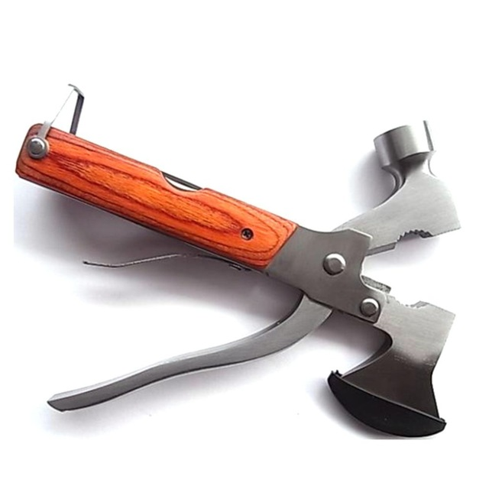
Future of Fitness Trackers
On the decline
Cost
Single function vs. Multifunction
Notes:
http://www.fitness360online.com/health-club-management-software/

Slide 12
Online Discussion: Pick One
Identify a current learning need and design a theoretical wearable item to meet this need. Share your idea with the class. You are not tied to current technological limits.
Chose a wearable technology currently used in your daily life and discuss how it could be adapted for a learning environment where resources may be scarce. An example may be using a fitness tracker in a small village in Indonesia to teach about math and geography.
Is there a piece of technology that faded out of favor that you feel could make a comeback and be used in education? Give a brief history of the technology and discuss how it may be used in a new and modern way. Do not feel tied to current technological limits if it needs to be modified.
If given the opportunity and sufficient funding, what wearable technology would you incorporate into a K-12 setting to improve teaching and learning and why? Discuss its advantages and disadvantages.
What wearable tech device do you believe will assist with engaging students in deeper learning while targeting the emotional and social aspect of each learner?
In regards to the data collected by fitness trackers; is this data protected by HIPPA or FERPA? Can or will it be used in courts to the same extent as DNA or fingerprints in litigation?

Slide 13
Thank you!

